Slide 1
Binary Search Trees
CS340

Slide 2
Binary Search Trees
Linked data structure where each node is an object
Each node contains:
key (+ other data)
pointers to left child, right child, and parent
Satisfies the binary search tree property:
If y is a node in the left subtree of x, then y.key ≤ x.key.
If y is a node in the right subtree of x, then y.key ≥ x.key.
Binary search property is recursively true for every node

Slide 3
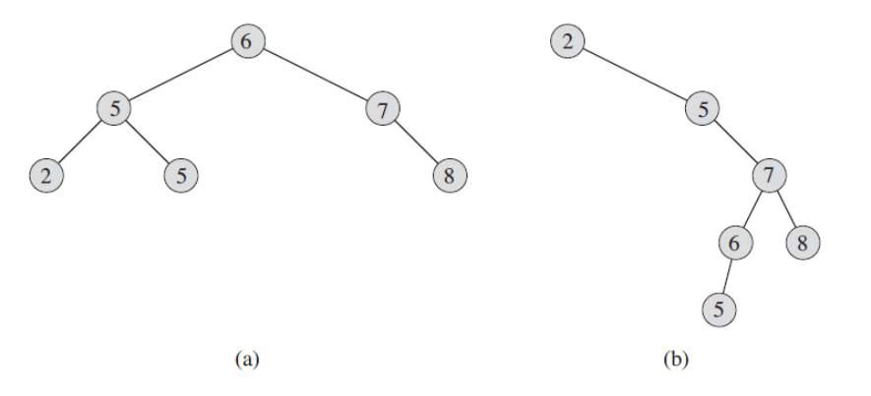
Two binary search trees
representing the same data

Slide 4
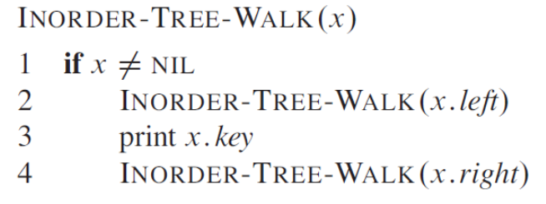
Printing keys in sorted order
Use an inorder walk
Recursively walks left node, then root, then right node
Visits each node once. Θ(n)
(preorder walk prints root node first, postorder prints root node last)

Slide 5
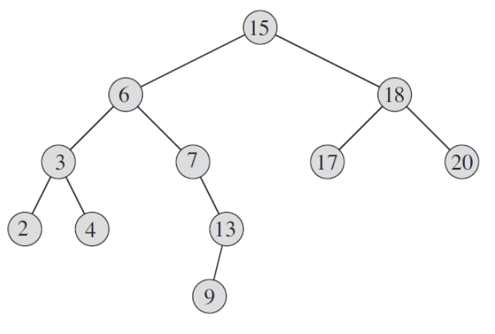
Inorder walk

Slide 6
Interview Questions
For the set {1, 4, 5, 10, 16, 17, 21} of keys, draw binary search trees of heights 2, 3, 4, 5, and 6.
What is the difference between the binary-search-tree property and the min-heap property?
Can the min-heap property be used to print out the keys of an n-node tree in sorted order in O(n) time?
Give recursive algorithms that perform preorder and postorder tree walks in Θ(n) time on a tree of n nodes.

Slide 7
Binary search tree methods
SEARCH
MINIMUM
MAXIMUM
SUCCESSOR
PREDECESSOR
all O(h) on a tree of height h

Slide 8
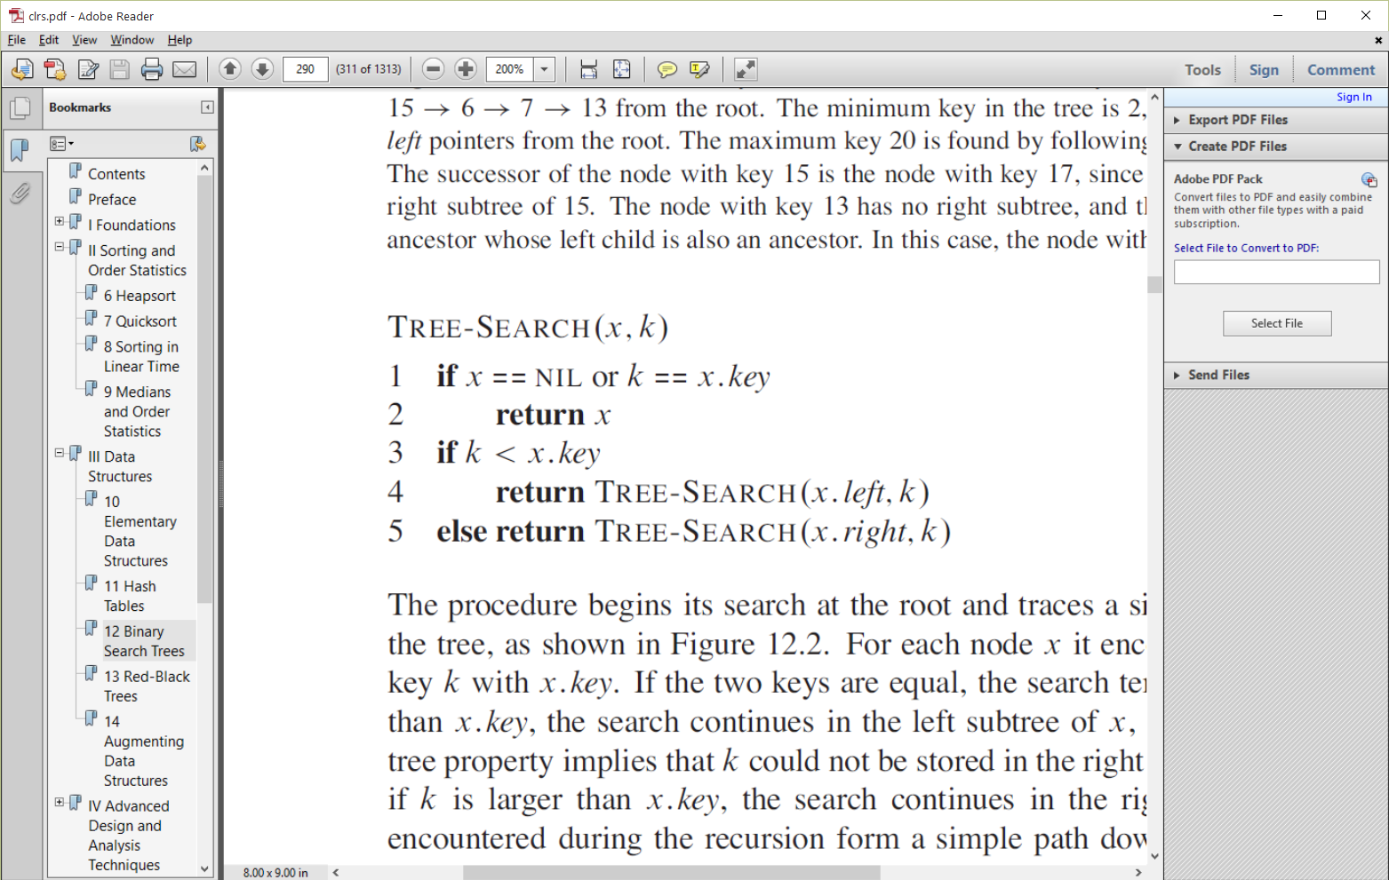
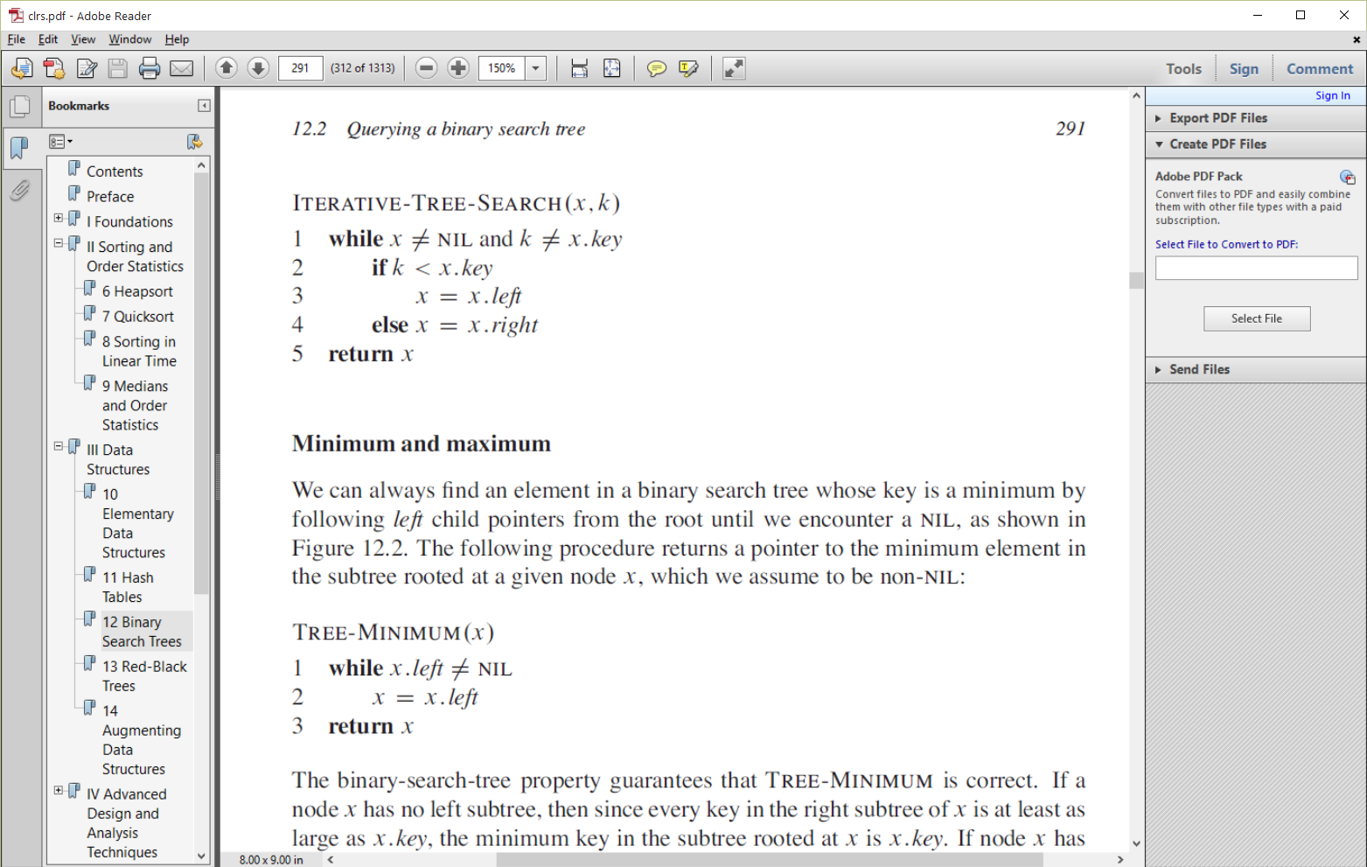
SEARCH
Follow left or right based on less than or greater than

Slide 9
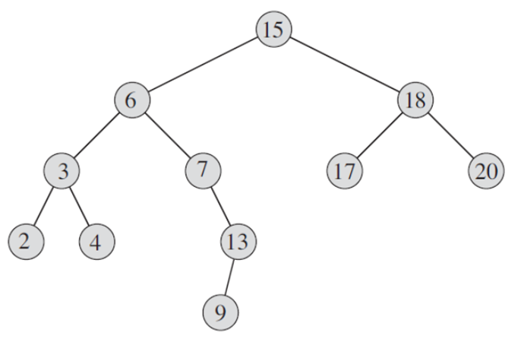
Finding minimum and maximum
Where are min and max?
min(node x) {
}
max(node x) {
}

Slide 10
Finding the successor
If right subtree exists, choose min of right subtree
else go up the tree from x until we encounter a node that is the left child of its parent

Slide 11
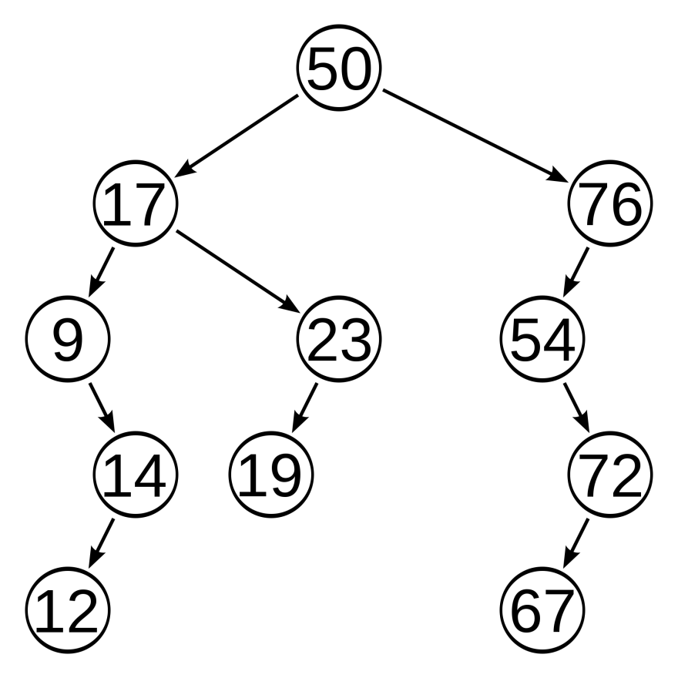
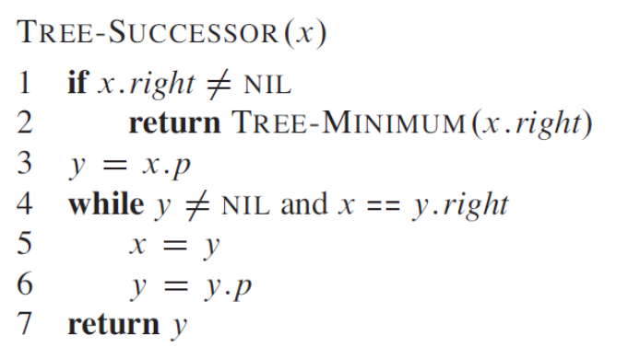
Finding the successor

Slide 12
Interview Questions
Suppose that we have numbers between 1 and 1000 in a binary search tree, and we want to search for the number 363. Which of the following sequences could not be the sequence of nodes examined?
a. 2, 252, 401, 398, 330, 344, 397, 363.
b. 924, 220, 911, 244, 898, 258, 362, 363.
c. 925, 202, 911, 240, 912, 245, 363.
d. 2, 399, 387, 219, 266, 382, 381, 278, 363.
e. 935, 278, 347, 621, 299, 392, 358, 363.
continued →

Slide 13
Interview Questions
Write recursive versions of TREE-MINIMUM and TREE-MAXIMUM.
Write the TREE-PREDECESSOR procedure
An alternative method of performing an inorder tree walk of an n-node binary search tree finds the minimum element in the tree by calling TREE-MINIMUM and then makes n-1 calls to TREE-SUCCESSOR.
What is the omega for this walk?
How many times is each edge traversed?
What is the theta for this walk?

Slide 14
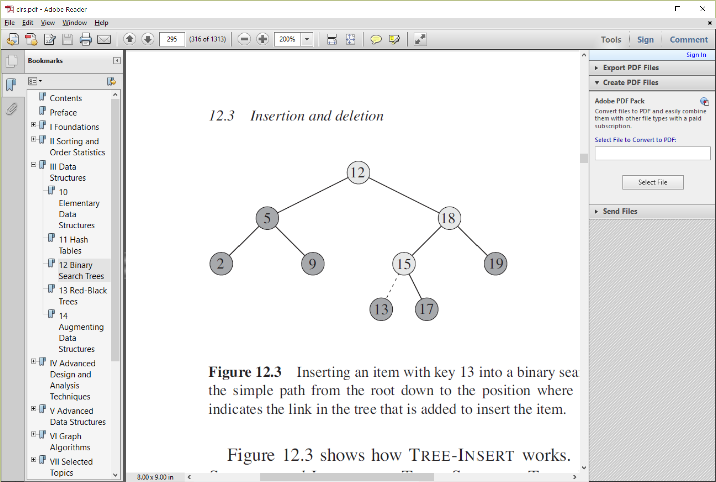
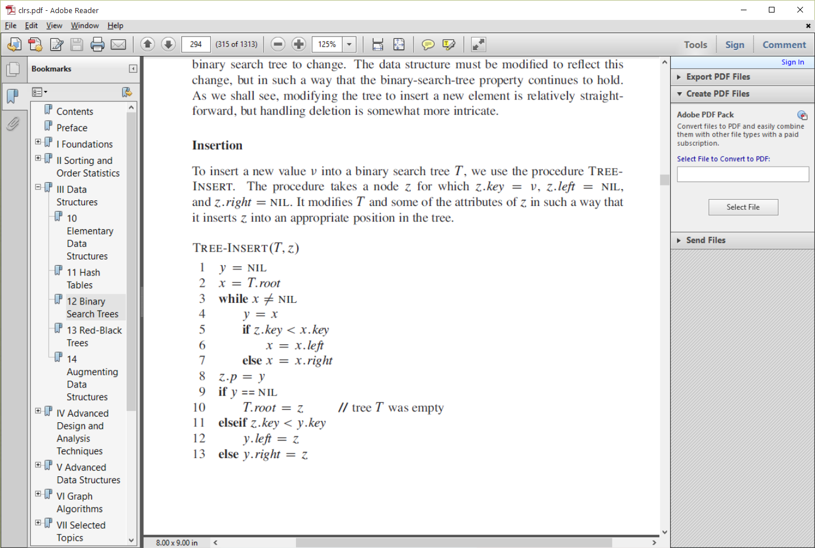
Inserting a node
O(h)

Slide 15
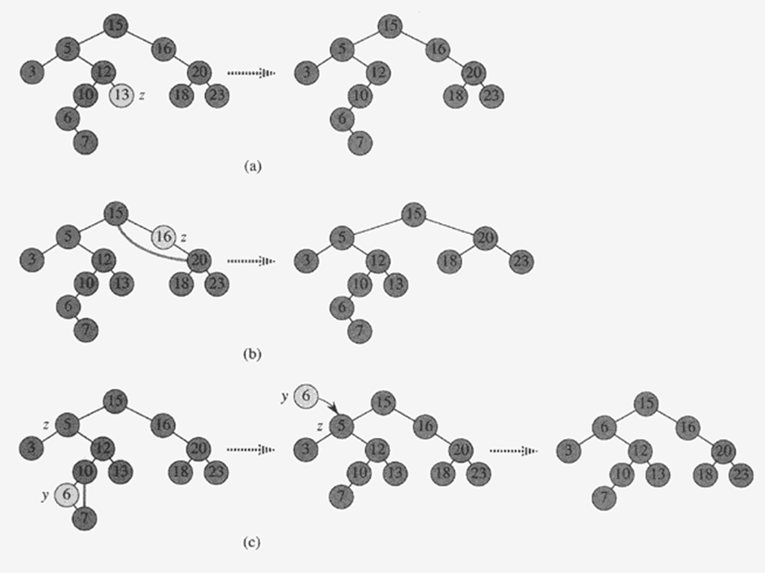

Delete z
No children, remove z
1 child, splice it out
2 children, splice out (y) successor, then replace z key with successor key
This is a simple approach, but external links to y become stale

Slide 16
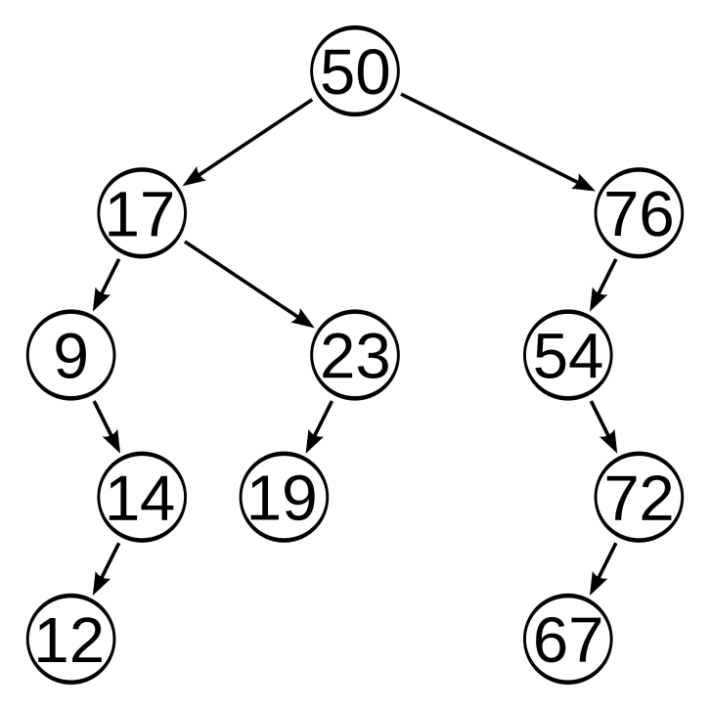
Better way to delete node z
if z has no children
replace parent's pointer to z with null
if z has one child
that child can take z's place
if z has two children
find z’s successor y, (lies in z’s right subtree and has no left child)
if y is z's right child, replace z with y
if y is not z's right child
1. replace y with its own right child
2. replace z with y
Q: Why are we replacing z with the min node on the right side?

Slide 17
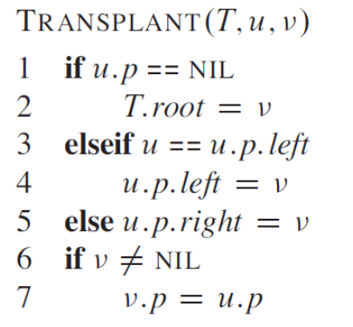
Transplant
Replaces the subtree rooted at node u with the subtree rooted at node v

Slide 18
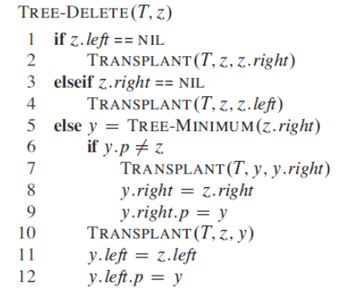
A better TREE-DELETE

Slide 19
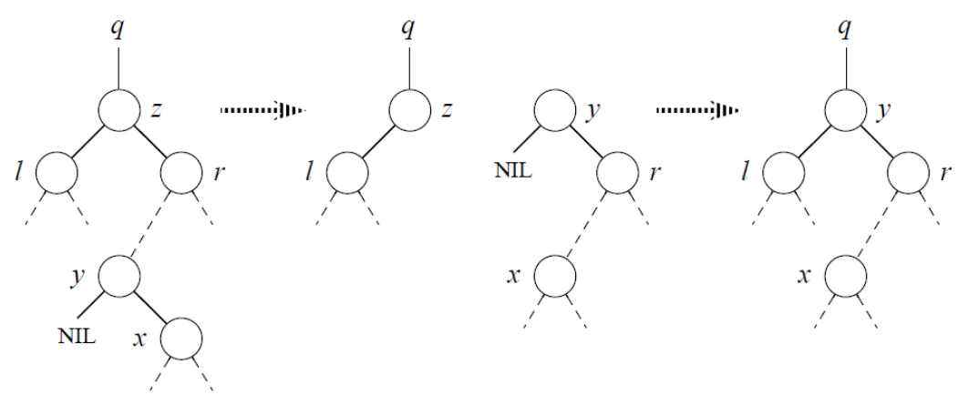
Last condition for delete
z is being deleted. y is the successor to z. Replace y by its own right child. Then replace z by y.

Slide 20
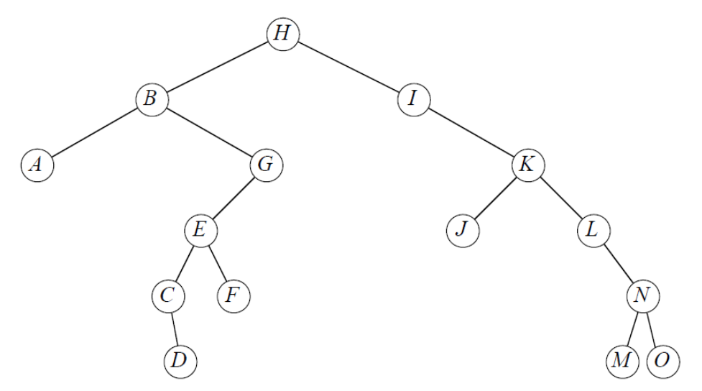
Practice Delete
Tree-Delete(T, I)
Tree-Delete(T, G)
Tree-Delete(T, K)
Tree-Delete(T, B)

Slide 21
Interview Questions
Give a recursive version of the TREE-INSERT procedure.
We can sort a given set of n numbers by first building a binary search tree containing these numbers (using TREE-INSERT repeatedly to insert the numbers one by one) and then printing the numbers by an inorder tree walk. What are the worst case and best-case running times for this sorting algorithm?

Slide 22
How big is h?
The expected height of a randomly built binary search tree on n distinct keys is O(lg n)
How to avoid an n-height tree?

